Slide 1

Introductions
ACDVO
Domestic Violence Staff Seminar
For a copy of this slide deck see Resource Manual in the Awareness Section.
https://pvm.archchicago.org/human-dignity-solidarity/domestic-violence-outreach/resource-manual - training
    2-Hours - September 2020
Notes:
1995 Hope Delores Tapia
2007 Fr. Chuck Preaching
2010 Connect with Fr. Chuck and began building a organization.
2011 Appointed
2020 150 parishes – 75 active

Slide 2
Introductions
Introductions
Notes:
1995 Hope Delores Tapia
2007 Fr. Chuck Preaching
2010 Connection
2011 Fr. Chuck Appointed Director of ACDVO
2020 150 parishes – 75 active

Slide 3
Introductions
Mission
Awareness–Services–Prevention
Notes:
1995 Hope Delores Tapia
2007 Fr. Chuck Preaching
2010 Connection
2011 Appointed
2020 150 parishes – 75 active

Slide 4
Goals
  Establish an emotional and intellectual basis for understanding and ministering to domestic violence victims and witnesses, and for dealing with abusers.
  Recognize that prevention is a critical component of an effective domestic violence ministry.
  Provide sound information, good reference materials, and useful resources.

Slide 5
Agenda
1:00 – Introductions, Mission, and Goals [10]
1:10 – Leslie's Story: “Crazy Love” [20]
1:35 – DV Dynamics [10]
1:45 – Interacting with Victims, Abusers, and Children [10]
1:55 – Break [10]
2:05 – Nicci's Story: Teen Dating Violence [20]
2:25 – U.S. Catholic Bishops on DV [15]
2:40 – What Can Your Parish Do? [15]
2:55 – Evaluation [5]

Slide 6
Keep in Mind
  Both women and men are victims of domestic violence and dating violence.
  This presentation focuses on women as victims since approximately 85% of victims are women.
  Domestic violence and dating violence are never the victim’s fault.
Notes:
This does not in any way intend to diminish men’s suffering.

Slide 7
Keep in Mind
Tips
  Try to absorb the major concepts of today’s presentation. Don’t worry about notes.
  We will email this presentation.
  Slides are jam packed with information. We will not read the slides to you.
  The material requires future study.

Slide 8
First Person Accounts
    Leslie Morgan Steiner - “Crazy Love”
    Questions to consider as you watch this video:
      What trapped Leslie?
      How did she remedy her problem?
https://www.youtube.com/watch?v=V1yW5IsnSjo

Slide 9
Domestic Violence Dynamics
  Definition
  Abuse Dimensions
  Myths and Facts
  Cycle of Domestic Violence
  Signs and Symptoms of Domestic Violence
  Why Victims Stay
  Abusers
  Please see appendix for addition information.
  Father Charles W. Dahm, O.P. www.domesticviolenceoutreach.org
  Reverend Joyce Galvin http://www.womenofvalorministry.org/home_page0.aspx

Slide 10
Definition
Domestic violence:
  is a pattern of abuse used to exert power and control over another person.
Notes:
It is in the context of a dating, family, or household relationship

Slide 11
What Causes Domestic Violence?
Domestic violence appears to be learned behavior, but not exclusively learned behavior.
  Family, community, and culture are teachers.
  DV is rooted in the abuser’s decision to use power and control.
Domestic Violence Abuse Intervention Programs, Wheel Gallery, http://www.theduluthmodel.org/training/wheels.html.
Notes:
We don’t know why some kids learn and some kids don’t.
Then there are kids come from very healthy families and they turnout to be abusers.

Slide 12
Power and Control Wheel
Using Intimidation
Using Emotional Abuse
Using Isolation
Minimizing, Denying, and Blaming
Using Children
Using Male Privilege
Using Economic Abuse
Using Coercion and Threats
Notes:
You will see these elements in the first person account.

Slide 13
Abuse Dimensions
  The Centers for Disease Control and Prevention (CDC) defines four types of abuse. We add a fifth category.
    Physical
    Sexual
    Stalking
    Psychological & Economic
“National Intimate Partner and Sexual Violence Survey (NISVS), 2010,” Centers for Disease Control and Prevention(CDC). The survey is comprised of 16,507 completed interviews, 9,086 women and 7,421 men.⁵ NISVS Data Brief -Updated Release, 2015. The survey is comprised of 10,081 completed interviews, 5,758 women and 4,323 men, 2018. https://www.cdc.gov/violenceprevention/pdf/nisvs_sofindings.pdf
Notes:
We have added Economic because it is very frequently seen.
Psychological includes emotional abuse.

Slide 14
Abuse Dimensions
Women: Contact Sexual Violence, Physical Violence, and/or Stalking by an Intimate Partner
2015 Study, Life-time Prevalence
All variables 36.4%
          Sexual 18.3%
            (Rape, Penetrate, Coercion, Unwanted Contact)
  Physical 30.6%
  Stalking 10.4%
IPV*-Impact: 25.1%
          *Intimate Partner Violence
Notes:
Contact sexual violence includes rape (21.3 all women), being made to penetrate someone else, sexual coercion, and/or unwanted sexual contact.
Severe physical violence (21.4) includes hit with a fist or something hard, kicked, hurt by pulling hair, slammed against something, tried to hurt by choking or suffocating, beaten, burned on purpose, used a knife or gun.
IVP – Impact Includes experiencing any of the following: being fearful, concerned for safety, injury, need for medical care, needed help from law enforcement, missed at least one day of work, missed at least one day of school. PTSD any post-traumatic stress disorder symptoms, need for housing services, need for victim advocate services, need for legal services and contacting a crisis hotline.
All variables: 36.4%, 43.6 million
Contact Sexual: 18.3%, 21.9 million
Physical: 30.6%, 36.6 million
Stalking: 10.4%, 12.5 million
IPV*-Impact: 25.1%, 30.0 million

Slide 15
Abuse Dimensions
LGBTQ – Bisexual & Lesbian
Women: Rape, Physical Violence, and/or Stalking by an Intimate Partner
2010 Study – Issued in 2013, Life-time Prevalence
Bisexual: 61.1%
  IPV-Impact: 57.4%
Lesbian: 43.8%
  IPV-Impact: 33.5%
Notes:
Women: 95.8% – hetero. 2.2% bisexual, 1.3% lesbian. Total 3.8% Men; 96.8% heterosexual. 1.2% bisexual, 2.0% gay. Total 3.2% Grand total: 6.7%
Bisexual: 61.1%, 2.0 million
IPV-Impact: 57.4%, 1.9 million
Lesbian: 43.8%, 714 thousand
IPV-Impact: 33.5%, 547 thousand

Slide 16
Abuse Dimensions
    Women: Psychological by an Intimate Partner
        2015 Study, Life-time Prevalence
All Psychological: 36.4%
    Expressive aggression: 25.7%
      Insult, humiliate …
    Any coercive control: 30.6%
      Financial, isolate, threaten …
Notes:
Expressive aggression
Acted very angry in a way that seemed dangerous
Told they were a loser, a failure, or not good enough
Called names like ugly, fat, crazy, stupid
Told no one else would want them
Coercive Control
Tried to keep from seeing or talking to family or friends
Kept track of by demanding to know where you were and what you were doing
All Psychological: 36.4%, 43.6 million
Expressive aggression: 25.7%, 43.5.9 million
Insult, humiliate …
Any coercive control: 30.6%, 30.8 million
Financial, isolate, threaten …

Slide 17
Abuse Dimensions
  Economic
    Not allowing participation in financial decision-making. The abuser makes all the decisions.
    Withholding resources such as cash or credit cards
    Withholding food, clothing, shelter, medications…
    Preventing from working, studying…
Notes:
Deportation for undocumented persons.

Slide 18
Demographics
Women: Abuse by Rape, Physical Violence, and/or Stalking by an Intimate Partner
2010 Study, Life-time Prevalence
Multiracial: 53.8%
Am. Indian: 46.0%
Black: 43.7%
Hispanic: 37.1%
White: 34.6%
Asian: 19.6%
Notes:
Multiracial: 53.8%, or 0.7 million
Am. Indian: 46.0%, or 0.4 million
Black: 43.7%, or 6.4 million
Hispanic: 37.1%, or 5.6 million
White: 34.6%, or 28.1 million
Asian: 19.6%, or 1.1 million

Slide 19
Myths and Facts
Myth: Drugs, alcohol, stress, mental illness, unemployment, children, poverty, childhood trauma… cause domestic violence
Fact: Many factors are stressors, but are not the cause of DV.
Notes:
Fact: Those under the influence of alcohol don’t beat up their bosses.

Slide 20
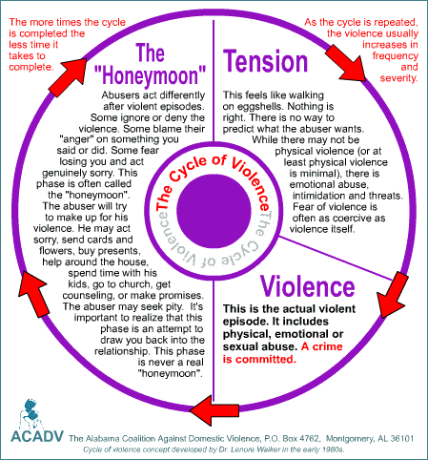
Notes:
Time between incidences tends to shorten and frequency of incidences increases.

Slide 21
Victims Signs and Symptoms
  Isolation from family, friends, church
  Depression, passivity, anxiety, panic, drug use
  Health issues, bruises, eating and sleep disorders
  Excuses for partner
  Denial of seriousness of situation, minimization
  Withdrawal
  Poor job performance

Slide 22
Witnesses – Children
Signs and Symptoms
  Fear, anxiety, depression
  Develop slower
  Difficulty learning
  PTSD Post-traumatic stress syndrome
  Hyperactivity
  Withdrawal
Notes:
These signs and symptoms maybe the result of other factors.

Slide 23
Why Victims Stay
    Don’t know it is domestic violence.
    Believe abuser will change
    Children
    Economic
    Denial
    Identity and status
    Fear
    Religious beliefs

Slide 24
Abusers
    Abusers are found in all:
      Races
      Sexual orientations
      Religions
      Neighborhoods
      Socioeconomic groups
      Ethnicities
      Educational levels
      Professions and walks of life

Slide 25
Interacting
  Victims
  Children
  Abusers
  Please see appendix for addition information.

Slide 26
Interacting with Victims
  Listen
  Acknowledge
  Connect
Notes:
You feel it is necessary to get both sides of the story because…
You want to be fair.
You are afraid that the victim may be exaggerating or that the victim may be the cause of the problem.
Same concept as couples counseling

Slide 27
Interacting with Victims
  Validate victim’s feelings.
    I believe you.
    You are not alone.
    I know it is very difficult.
  Father Charles W. Dahm, O.P. www.domesticviolenceoutreach.org
  Reverend Joyce Galvin http://www.womenofvalorministry.org/home_page0.aspx

Slide 28
Interacting with Children
  Children need to hear that DV:
    It is not your fault.
    It must be scary for you.
    I will listen to you.

Slide 29
Interacting with Abusers
Be clear with the abuser:
  Anger management and drinking issues, should be treated separately.
  Remorse is not the same as changing behavior.
  Recommend individual counseling.
Notes:
Remorse, being sorry, is not the same as repentance, a change in behavior.

Slide 30
Interacting with Children
Children who live with domestic violence feel:
  Powerless. They can’t stop the violence.
  Confused. It doesn’t make sense.
  Angry. It shouldn't be happening.
  Guilty. They think they’ve done something wrong.
  Sad. It’s a loss.
  Afraid. They may be hurt, lose someone they love, or others may find out.
  Alone. They think it’s happening only to them.
  ADVA (Against DV & Abuse), Devon County Council, UK¹⁰–quoted

Slide 31
Interacting with Children
  Kids need counseling.

Slide 32
Interaction
Do No Harm!
    If you are not sure of a course of action, talk to a professional.

Slide 33
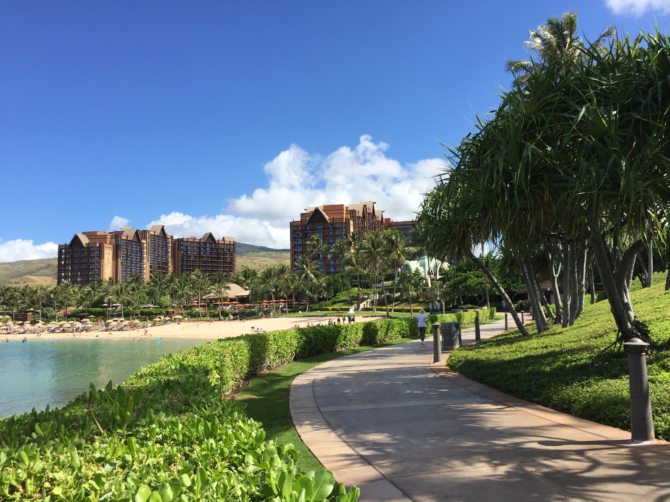
Break Time

Slide 34
First Person Accounts
    Nicci’s Story: Teen Dating Violence
    Questions to consider as you watch this video:
      What makes an impression on you?
      Are there any similarities between Nicci and Leslie’s stories?
      What action did Nicci take?
      https://www.youtube.com/watch?v=oyjIEZY-Wyo&t=2s

Slide 35
  Unhealthy Relationship Traps
    “I didn’t know it was abuse.”
    “I thought I could fix it.”
    “I kept silent.”
    Recognizing unhealthy relationships and knowing what action to take are critical.

Slide 36
Consequences for Victims
  A survey of U.S. high school students suggests that 1 in 5 female students and 1 in 10 male students who date have experienced some form of physical and/or sexual teen dating violence during the past 12 months.¹
  CDC, https://vetoviolence.cdc.gov/sites/vetoviolence.cdc.gov.apps.dating-matters-toolkit/themes/dmh_ng_bootstrap/assets/pdf/Educator-Training-Manual-Combined-PDF.pdf

Slide 37
Consequences for Victims
  A recent study evaluated the relationship between dating violence and suicide attempts among urban teens aged 14 and older.
  According to this study, teen girls who experienced recent dating violence were 60% more likely to report at least one suicide attempt in the past year than those who did not experience recent dating violence.⁴
  CDC, https://vetoviolence.cdc.gov/sites/vetoviolence.cdc.gov.apps.dating-matters-toolkit/themes/dmh_ng_bootstrap/assets/pdf/Educator-Training-Manual-Combined-PDF.pdf

Slide 38
Consequences for Victims
  Increased absenteeism
  Problems in non-dating relationships
  Decline in well-being
  Failure to participate in school activities
  Poor academic performance
  Thoughts of suicide
  CDC, https://vetoviolence.cdc.gov/sites/vetoviolence.cdc.gov.apps.dating-matters-toolkit/themes/dmh_ng_bootstrap/assets/pdf/Educator-Training-Manual-Combined-PDF.pdf
Notes:
A recent study evaluated the relationship between dating violence and suicide attempts among urban teens aged 14 and older. According to this study, teen girls who experienced recent dating violence were 60% more likely to report at least one suicide attempt in the past year than those who did not experience recent dating violence.

Slide 39
Consequences for Victims
  Fear
  Depression and/or anxiety
  Drug, alcohol, and tobacco use
  Injury
  Delinquent behavior
  Experiencing violence in subsequent relationships
  CDC, https://vetoviolence.cdc.gov/sites/vetoviolence.cdc.gov.apps.dating-matters-toolkit/themes/dmh_ng_bootstrap/assets/pdf/Educator-Training-Manual-Combined-PDF.pdf
  .

Slide 40
Consequences for Abusers
  Loss of friend’s respect
  Poor academic performance
  Alienation from friends and family
  Physical and health problems
  Juvenile or criminal record/confinement
  Loneliness
  Expulsion from school
  Loss of job
  CDC, https://vetoviolence.cdc.gov/sites/vetoviolence.cdc.gov.apps.dating-matters-toolkit/themes/dmh_ng_bootstrap/assets/pdf/Educator-Training-Manual-Combined-PDF.pdf

Slide 41
Teen Dating Violence
  22.4% of women and 15.0% of men first experienced some form of partner violence between 11 and 17 years of age.
“National Intimate Partner and Sexual Violence Survey, 2010,” Centers for Disease Control and Prevention(CDC). The survey is comprised of 16,507 completed interviews, 9,086 women and 7,421 men.https://www.cdc.gov/violenceprevention/pdf/nisvs_sofindings.pdf

Slide 42
Teen Dating Violence
  Avoidance of Help-Seeking
    60% of victims did not seek help.
    79% of perpetrators did not ask for help.
Notes:
Only 32% of male adolescents and 44% of female adolescents who report dating violence seek help.

Slide 43
Warning Signs – Victims
    Isolation
    Loss of interest
    Loss of self-confidence
Notes:
Makin excuses for a dating partnet
Changes in eating or sleeping patterns, or alcohol or drug use
Loss of self-confidence

Slide 44
Warning Signs – Abusers
    Threats and Insults
    Attempting to control appearance
    Constant attention and presence
Notes:
Threatening to hurt others in any way
Insulting a dating partner in public or private
Insisting on walking a dating partner to each class
Damaging or destroying a dating partner’s personal belongings
Attempting to control what a dating partner wears
A question we have is: Is there a difference between teenage abusers and adult abuser.

Slide 45
STOP! Signs for Teens: Your partner…
  Physically or sexually abuses you one time.
  Tries to isolate you from family and friends.
  Attempts to destroy your self-esteem and self-confidence.
  Tries to pressure you into doing things.
  You think you need to rescue or change your partner. ….You can’t.

Slide 46
What do you do if you are in an abusive relationship?
Talk with parents or other trustworthy adult.
Dating Violence: Love is Respect
https://www.loveisrespect.org
Call 1.866.331.9474 or Chat
Text: “Loveis” at 1.866.331.9474 (Temporary #)
Sexual Violence: RAINN (Rape, Abuse, Incest)
https://www.rainn.org
Call 1.800.656.4673 or Chat
Notes:
RAINN – Rape, Abuse, Incest National Network

Slide 47


“When I Call for Help”
A Pastoral Response to Domestic Violence Against Women
    United States Conference of Catholic Bishops, Pastoral Response on Domestic Violence,
      http:www.usccb.org/issues-and-action/marriage-and-family/marriage/domestic-violence/when-i-call-for-help.cfm
Notes:
First issued 1992; reissued in 2002.
These are quotes.

Slide 48
  The Bishops’ Position on Domestic Violence
  “As pastors of the Catholic Church in the United States,
    we state as clearly and strongly as we can that violence against women , inside or outside the home, is never justified.”
  USCCB, 2002-quoted including the following slides in this section.

Slide 49
The Bishops’ Position on Domestic Violence
    A correct reading of Scripture:
      leads to an understanding of the equal dignity of men and women and to relationships based on mutuality and love.
Notes:
Resource:
– religion encourages women to resist mistreatment.
Roadblock:
– its misinterpretations can contribute to the victim’s self-blame and suffering due to the abuser’s rationalizations.

Slide 50
The Bishops’ Position on Domestic Violence
    Forgiveness does not mean forgetting the abuse or pretending it did not happen.
    Forgiveness is not permission to repeat the abuse.
Notes:
Husbands should love their wives as they love their own body, as Christ loves the Church.

Slide 51
The Bishops’ Position on Domestic Violence
    An abused woman's suffering is not punishment from God.
    This image of a harsh, cruel God runs contrary to the biblical image of a kind, merciful, loving God.

Slide 52
The Bishops’ Position on Domestic Violence
      Couples counseling is not appropriate and can endanger the victim’s safety.
Notes:
Individual counseling is fine.

Slide 53
The Bishops’ Position on Domestic Violence
    No person is expected to stay in an abusive marriage.
    We encourage abused persons who have divorced to investigate the possibility of seeking an annulment.

Slide 54
What Can Your Parish Do?
  Awareness
  Services
  Prevention
  ACDVO Website
  www.domesticviolenceoutreach.org

Slide 55
Awareness
      Gives voice to victims’ silence.
      Provides hope. DV does not have to be a way of life.
      Educates abusers. Abuse is a crime and a sin.

Slide 56
Awareness
  Liturgies reach victims, witnesses, abusers, and the parish community at the same time.
  This opportunity cannot be duplicated.
    USCCB-adapted
Notes:
“Be aware of the fact that possibly some form of domestic violence may impact a third of those who will be listening to your homily on a given Sunday.”

Slide 57
Awareness
  “Just a simple and pastorally sound reference to
  domestic violence in a homily lets people know that it
  is okay to approach you about the matter for help.”
  USCCB-quoted
Notes:
“Be aware of the fact that possibly some form of domestic violence may impact a third of those who will be listening to your homily on a given Sunday.”

Slide 58
Awareness
  Utilize Prayers of the Faithful
  Describe what abuse is so that women recognize what is happening to them.
  Identify violence against women as a sin in parish reconciliation services.

Slide 59

Awareness: You are making a difference!
You are making a difference!
Most parish-based domestic violence outreach ministries do not interact directly with survivors.
As a result, it is difficult to know if our efforts count. However, even seemingly little things do.
We share an anonymous note received from Milwaukee, Wisconsin February 19, 2019.
To St. Raymond de Penafort Mount Prospect, Illinois:
Thank you for the signs in your restrooms about
domestic violence. As a survivor, I know they make
a difference.
Have a blessed day!
“B”
We share an anonymous note received from Milwaukee, Wisconsin February 19, 2019.
To St. Raymond de Penafort Mount Prospect, Illinois
Thank you for the signs in your restrooms about domestic violence. As a survivor, I know they make a difference.
Have a blessed day!
“B”

Slide 60
Services
Listen
Acknowledge
Connect

Slide 61
Services
Identify source of immediate support at National DV Hotline 800-799-7233.
Identify local agencies that will provide services for victims and children.
    Candidate interview and selection

Slide 62
Services
  Services provide support, healing and a path to freedom.
  Get professionals involved with your ministry.
    Support Groups and Counseling
    Orders of Protection
    Safety Planning
    Please see appendix for additional information.

Slide 63
Prevention
    Build Awareness. Know the dynamics of dating violence–its warning signs and stop signs.
    Identify Support Services. Help is available to prevent further hurt and unhappiness. Consult an adult they trust.
    Urge Action. Get out of an unhealthy relationship immediately.
Notes:
“An ounce of prevention is worth a pound of cure.” Ben Franklin

Slide 64
Prevention
    Love is Respect at 1.866.331.9474 or online www.loveisrespect.org. Text: “Loveis” at 1.866.331-9474. (Temporary. Check website.)
    National Domestic Violence Hotline at 800-799-7233

Slide 65
Prevention
  CDC Dating Matters Curriculum: Promotes Healthy Teen Dating Relationships
    Instruction: Grades 6, 7 & 8
    Demonstration Project: 2013 – 2018
    Available: September 2019
    ACDVO Pilot: 2020
    Centers for Disease Control and Prevention (CDC) Dating Matters Curriculum, http://www.cdc.gov/violenceprevention/datingmatters/index.html
Notes:
Baltimore, Ft. Lauderdale, Chicago & Oakland
12 Schools each; Oakland, 9 schools

Slide 66
Prevention
  Best Solution – A Healthy Relationship:
    Trust
    Mutual respect
    Shared decision-making
    Honesty
    Compromise
    Fighting fair
    Empathy

Slide 67
Prevention
  Best Solution – A Healthy Relationship:
    Nonviolent conflict resolution
    Ability to negotiate
    Open and honest communication
    Shared decision making
    Right to autonomy
    Individuality

Slide 68
– The Basics –
Establish a Relationship with Local DV Agency
Put DV Hotline Number in Your Cell Phone
Provide Bulletin Information
Link Parish Website to ACDVO Website
Provide DV Service Support Information to Parish Front Desk

Slide 70
– The Basics –
Homily Mentions Supporting Victims of DV
Place DV Support Information in Women’s Restrooms
Conduct DV Events in October Include Homilies at Mass
Conduct Teen DV Events in February Include Homilies at Mass
10. Attend ACDVO meeting and events.

Slide 71
– The Basics –
  Hosting an Event
  Do it yourself. Or, ACDVO presenters available.
    The Hunting Ground – College Bound +
      https://www.youtube.com/watch?v=GBNHGi36nlM
    Healthy Dating Relationships – Teens +
      https://pvm.archchicago.org/human-dignity-solidarity/domestic-violence-outreach/news-and-video-library
    Empowerment Project – Girl Scouts +
      https://www.youtube.com/watch?v=JTIogIwn8U0
      ACDVO copy available. License provided.
    Dating Project – High School Grades +
      https://www.youtube.com/watch?v=ID9STK-zdIg
Notes:
The Hunting Ground dvd is available of Amazon.com.

Slide 72
Parish Issues
  Culture
  Mandated Reporting
  Confidentiality
  Please see appendix.

Slide 73
Resources
  Find us at:
  Website www.domesticviolenceoutreach.org
  Resource Manual https://pvm.archchicago.org/human-dignity-solidarity/domestic-violence-outreach/resource-manual
Facebook: dvochicago
Instagram: dvochicago
Twitter: dvochicago

Slide 74

Loose Ends and Questions

Slide 75
Goals
  Establish an emotional and intellectual basis for understanding and ministering to domestic violence victims and witnesses, and for dealing with abusers.
  Recognize that prevention is a critical component of an effective domestic violence ministry.
  Provide sound information, good reference materials, and useful resources.

Slide 76

Evaluation

Slide 77
Appendices

Slide 78
Domestic Violence Dynamics
-Expanded-

Slide 79
Domestic Violence Dynamics
  Definition
  Abuse Dimensions
  Myths and Facts
  Cycle of Domestic Violence
  Signs and Symptoms of Domestic Violence
  Why Victims Stay
  Abusers
  Father Charles W. Dahm, O.P. www.domesticviolenceoutreach.org
  Reverend Joyce Galvin http://www.womenofvalorministry.org/home_page0.aspx

Slide 80
Definition
Domestic violence:
  is a pattern of abuse used to exert power and control over another person.
Notes:
It is in the context of a dating, family, or household relationship

Slide 81
What Causes Domestic Violence?
Domestic violence appears to be learned behavior, but not exclusively learned behavior.
  Family, community, and culture are teachers.
  DV is rooted in the abuser’s decision to use power and control.
Domestic Violence Abuse Intervention Programs, Wheel Gallery, http://www.theduluthmodel.org/training/wheels.html.
Notes:
We don’t know why some kids learn and some kids don’t.
Then there are kids come from very healthy families and they turnout to be abusers.

Slide 82
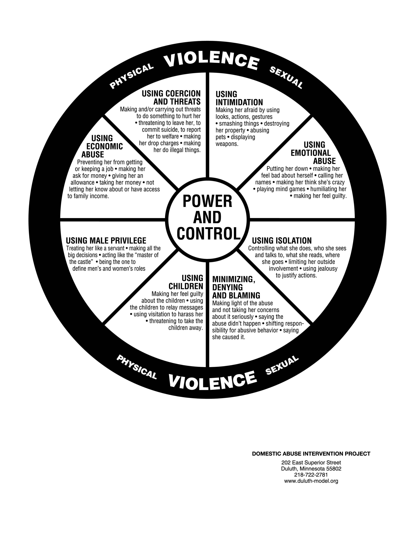

Slide 83
Power and Control Wheel
Using Intimidation
Using Emotional Abuse
Using Isolation
Minimizing, Denying, and Blaming
Using Children
Using Male Privilege
Using Economic Abuse
Using Coercion and Threats
Notes:
You will see these elements in the first person account.

Slide 84
Abuse Dimensions
  The Centers for Disease Control and Prevention (CDC) defines four types of abuse. We add a fifth category.
    Physical
    Sexual
    Stalking
    Psychological & Economic
“National Intimate Partner and Sexual Violence Survey (NISVS), 2010,” Centers for Disease Control and Prevention(CDC). The survey is comprised of 16,507 completed interviews, 9,086 women and 7,421 men.⁵ NISVS Data Brief -Updated Release, 2015. The survey is comprised of 10,081 completed interviews, 5,758 women and 4,323 men, 2018. https://www.cdc.gov/violenceprevention/pdf/nisvs_sofindings.pdf
Notes:
We have added Economic because it is very frequently seen.
Psychological includes emotional abuse.

Slide 85
Abuse Dimensions
Women: Contact Sexual Violence, Physical Violence, and/or Stalking by an Intimate Partner
2015 Study, Life-time Prevalence
All variables 36.4%
          Sexual 18.3%
            (Rape, Penetrate, Coercion, Unwanted Contact)
  Physical 30.6%
  Stalking 10.4%
IPV*-Impact: 25.1%
          *Intimate Partner Violence
Notes:
Contact sexual violence includes rape (21.3 all women), being made to penetrate someone else, sexual coercion, and/or unwanted sexual contact.
Severe physical violence (21.4) includes hit with a fist or something hard, kicked, hurt by pulling hair, slammed against something, tried to hurt by choking or suffocating, beaten, burned on purpose, used a knife or gun.
IVP – Impact Includes experiencing any of the following: being fearful, concerned for safety, injury, need for medical care, needed help from law enforcement, missed at least one day of work, missed at least one day of school. PTSD any post-traumatic stress disorder symptoms, need for housing services, need for victim advocate services, need for legal services and contacting a crisis hotline.
All variables: 36.4%, 43.6 million
Contact Sexual: 18.3%, 21.9 million
Physical: 30.6%, 36.6 million
Stalking: 10.4%, 12.5 million
IPV*-Impact: 25.1%, 30.0 million

Slide 86
Abuse Dimensions
LGBTQ – Bisexual & Lesbian
Women: Rape, Physical Violence, and/or Stalking by an Intimate Partner
2010 Study – Issued in 2013, Life-time Prevalence
Bisexual: 61.1%
  IPV-Impact: 57.4%
Lesbian: 43.8%
  IPV-Impact: 33.5%
Notes:
Women: 95.8% – hetero. 2.2% bisexual, 1.3% lesbian. Total 3.8% Men; 96.8% heterosexual. 1.2% bisexual, 2.0% gay. Total 3.2% Grand total: 6.7%
Bisexual: 61.1%, 2.0 million
IPV-Impact: 57.4%, 1.9 million
Lesbian: 43.8%, 714 thousand
IPV-Impact: 33.5%, 547 thousand

Slide 87
Abuse Dimensions
    Women: Psychological by an Intimate Partner
        2015 Study, Life-time Prevalence
All Psychological: 36.4%
    Expressive aggression: 25.7%
      Insult, humiliate …
    Any coercive control: 30.6%
      Financial, isolate, threaten …
Notes:
Expressive aggression
Acted very angry in a way that seemed dangerous
Told they were a loser, a failure, or not good enough
Called names like ugly, fat, crazy, stupid
Told no one else would want them
Coercive Control
Tried to keep from seeing or talking to family or friends
Kept track of by demanding to know where you were and what you were doing
All Psychological: 36.4%, 43.6 million
Expressive aggression: 25.7%, 43.5.9 million
Insult, humiliate …
Any coercive control: 30.6%, 30.8 million
Financial, isolate, threaten …

Slide 88
Abuse Dimensions
  Economic
    Not allowing participation in financial decision-making. The abuser makes all the decisions.
    Withholding resources such as cash or credit cards
    Withholding food, clothing, shelter, medications…
    Preventing from working, studying…
Notes:
Deportation for undocumented persons.

Slide 89
Demographics
Women: Abuse by Rape, Physical Violence, and/or Stalking by an Intimate Partner
2010 Study, Life-time Prevalence
Multiracial: 53.8%
Am. Indian: 46.0%
Black: 43.7%
Hispanic: 37.1%
White: 34.6%
Asian: 19.6%
Notes:
Multiracial: 53.8%, or 0.7 million
Am. Indian: 46.0%, or 0.4 million
Black: 43.7%, or 6.4 million
Hispanic: 37.1%, or 5.6 million
White: 34.6%, or 28.1 million
Asian: 19.6%, or 1.1 million

Slide 90
Myths and Facts
Myth: Drugs, alcohol, stress, mental illness, unemployment, children, poverty, childhood trauma… cause domestic violence
Fact: Domestic violence is about power and control. Many factors are stressors, but are not the cause of DV.
Notes:
Fact: Those under the influence of alcohol don’t beat up their bosses.

Slide 91
Myths and Facts
Myth: The abused or battered partner is the cause of the abuse.
Fact: Victims do not cause abuse.
Fact: Abusers are responsible for their behavior!

Slide 92
Myths and Facts
Myth: When abusers apologize, ask for pardon or promise to change, victims should believe them.
Fact: Abusers use “forgiveness and change” to control and manipulate their victims.

Slide 93
Myths and Facts
Myth: Children are unaware of the domestic violence in their homes.
Fact: Children are frequently eyewitnesses to most occurrences of domestic violence in their homes.
Fact: It is estimated that between 15 and 18 million children live in families were IPV occurred at least once during the previous year.
Rene McDonald et al., “Estimating the Number of American Children Living in Partner-Violent Families,” Journal of Family Psychology Vol. 20, No.1 (2006) 137–142. The estimate is based on 2001 United States census data. Updated: The estimate is based on 2010 United States census data.

Slide 94
Notes:
Time between incidences tends to shorten and frequency of incidences increases.

Slide 95
Victims Signs and Symptoms
  Isolation from family, friends, church
  Depression, passivity, anxiety, panic, drug use
  Health issues, bruises, eating and sleep disorders
  Excuses for partner
  Denial of seriousness of situation, minimization
  Withdrawal
  Poor job performance

Slide 96
Witnesses – Children
Signs and Symptoms
  Fear, anxiety, depression
  Develop slower
  Difficulty learning
  PTSD Post-traumatic stress syndrome
  Hyperactivity
  Withdrawal
Notes:
These signs and symptoms maybe the result of other factors.

Slide 97
Why Victims Stay
    Don’t know it is domestic violence.
    Believe abuser will change
    Children
    Economic
    Denial
    Identity and status
    Fear
    Religious beliefs

Slide 98
Abusers
    Abusers are found in all:
      Races
      Sexual orientations
      Religions
      Neighborhoods
      Socioeconomic groups
      Ethnicities
      Educational levels
      Professions and walks of life

Slide 99
Abusers
    Abusers Are Jealous
      Abusers contend that jealousy is an expression of love.
      They are often jealous of children, family, and friends.
      They often check up and demand checking in.

Slide 100
Abusers
    Abusers – Jekyll-and-Hyde Personality
      Charming
      Nice
      Smart
      Clever
      Destructive
Notes:
Cleaver – Hide abuse well.

Slide 101
Abusers
    Abusers Often Claim to Be the Victim
      “It isn’t me!”
      “You made me so mad. It is your fault I am the way that I am.”
      “I was just defending myself.”

Slide 102
Interacting – Expanded -
  Victims
  Children
  Abusers

Slide 103
Interacting with Victims
  Listen
  Acknowledge
  Connect
Notes:
You feel it is necessary to get both sides of the story because…
You want to be fair.
You are afraid that the victim may be exaggerating or that the victim may be the cause of the problem.
Same concept as couples counseling

Slide 104
Interaction
Do No Harm!
    If you are not sure of a course of action, talk to a professional.

Slide 105
Interacting with Victims
      Be sensitive to any comments about or signs of domestic violence.
      Talk in private if she or he agrees.
      Respect victim’s choices.
      Empower.
      You cannot rescue the victim.

Slide 106
Interacting with Victims
  Validate victim’s feelings.
    I believe you.
    You are not alone.
    I know it is very difficult.

Slide 107
Interacting with Victims
  Be prepared for comments like:
    I am worthless.
    I am ashamed.
    I will never trust or love anyone again.
    I will never get out of this relationship.
    He will kill me.

Slide 108
Interacting with Victims
    Why does domestic violence happen?
    Why has God abandoned me?
    My sin has caused this.
    I do not feel God’s presence.
    I do not believe in God.

Slide 109
Interacting with Victims
  Do not:
    blame the victim.
    encourage dependence on you.
    minimize the danger.

Slide 110
Interacting with Victims
  Do
    Accompany the victim through steps the victim chooses:
    Calling shelters
    Visiting a police station
    Give the victim referral information and resources.

Slide 111
Interacting with Victims
  Do not:
    encourage the victim to forgive the abuser and take them back.
    direct her to submit to the abuser.
    send her home with just a prayer.
Notes:
Do not direct her bring the abuser to church, or be a better Christian wife.

Slide 112
Interacting with Victims
  Do not
    make a joint appointment for the victim and the abuser.
    This can be dangerous.
Notes:
You feel it is necessary to get both sides of the story because…
You want to be fair.
You are afraid that the victim may be exaggerating or that the victim may be the cause of the problem.
Same concept as couples counseling

Slide 113
Interacting with Victims
  Do not
    recommend marriage counseling.
    encourage the victim to forget.
    give victim tips on how not to avoid antagonizing her abuser.
Notes:
Your bias is to save the marriage. This is a problem in the case of domestic violence.

Slide 114
Interacting with Children
  Children need to hear that DV:
    It is not your fault.
    It must be scary for you.
    I will listen to you.

Slide 115
Interacting with Children
  Ideas for helping children when they have witnessed domestic violence.
    You do not deserve to have this in your family.
    You can tell me how you feel.
    I will help to keep you safe.
Notes:
Accept that children may not be willing or able to talk about it right away.

Slide 116
Interacting with Children
Children who live with domestic violence feel:
  Powerless. They can’t stop the violence.
  Confused. It doesn’t make sense.
  Angry. It shouldn't be happening.
  Guilty. They think they’ve done something wrong.
  Sad. It’s a loss.
  Afraid. They may be hurt, lose someone they love, or others may find out.
  Alone. They think it’s happening only to them.

Slide 117
Interacting with Children
  Kids need counseling.

Slide 118
Interacting with Abusers
Be prepared:
  Abusers lie and are self-absorbed.
  Righteous, arrogant, and narcissistic.
  Jealous or envious.

Slide 119
Interacting with Abusers
Be prepared.
  In denial. Likely to be a charmer.
  Angry, simmering, and explosive.
  Lacking remorse and refusing advice.

Slide 120
Interacting with Abusers
Be clear with the abuser:
  Anger management and drinking issues, should be treated separately.
  Remorse is not the same as changing behavior.
Notes:
Remorse, being sorry, is not the same as repentance, a change in behavior.

Slide 121
Interacting with Abusers
  Do not:
    give the abuser any information about the victim.
    advocate for the abuser in order to avoid the legal consequences of his violence.
    send abuser home with just a prayer.

Slide 122
Interacting with Abusers
Identify support services for the abuser.
  Recommend individual counseling.
  Twenty-four-week counseling programs are available.
  Guide them to the appropriate community resources.
Notes:
Programs tend not to be very effective.
A lot of work has to be done in this area.

Slide 123
Services
- Expanded -
    Support Groups and Counseling
    Orders of Protection
    Safety Planning

Slide 124
Services
  Services provide support, healing and a path to freedom.
  Get professionals involved with your ministry.
    Support Groups and Counseling
    Orders of Protection
    Safety Planning

Slide 125
  Services
  Get professionals involved with your ministry.
  Support Group Facilitator Requirements
    40 hours’ training
    Field Experience - one year at an agency
    Understanding of the techniques and guidelines for facilitating a group
    Professional supervision and consultation. A licensed mentor is required.
Notes:
We are advocates. Get the professionals involved.

Slide 126
Services
  Get professionals involved with your ministry.
  Professional Counseling
    Professional license or relevant master’s degree with supervision
    40 hours’ training - Victims
    20 hours’ training - Perpetrators
Notes:
We are advocates. Get the professionals involved.

Slide 127
Services
Orders of Protection
  An order of protection may or may not be effective in preventing further abuse.
  Orders of protection are frequently ignored by many abusers.
  But it is still necessary and important evidence for legal documentation.
    Illinois Attorney General, “Orders of Protection,” http://www.illinoisattorneygeneral.gov/women/victims.html
Notes:
Some abusers take heed. Those who do not are subject to legal consequences. Depending upon the presiding judge, enforcement may be strong or weak.

Slide 128
Safety Planning
  A safety plan is a tool to help a victim think about how to protect themselves and their family from abuse.
  Local domestic violence agencies can provide help in developing individual safety plans.
    Illinois Coalition Against Domestic Violence, ”Safety Planning.” https://www.ilcadv.org/safety-planning-for-survivors/

Slide 129
Parish Issues – Expanded -
  Culture
  Mandated Reporting
  Confidentiality

Slide 130
Parish Culture
  Norms, Traditions, and Ministry
    Cultures vary greatly.
    What is effective in one parish community may not translate to another community.
    One size does not fit all.

Slide 131
Mandated Reporting
Guidelines for Calling the Child Abuse Hotline
  Mandated reporters are required to call.
    Other persons should call the Hotline when they have reasonable cause to suspect that a child has been abused or neglected.
  Illinois Child Abuse Hotline 1-800-252-2873
  1-800-358-5117 (TTY)
    Manual for Mandated Reporters, September 2012, Revised Edition,
    https://www.illinois.gov/dcfs/safekids/reporting/Documents/CFS_1050-21_Mandated_Reporter_Manual.pdf
    Manual for Mandated Reporters September 2012, Revised Edition, adapted.¹⁷
Notes:
The Hotline worker will determine if the information given by the reporter meets the legal requirements to initiate an investigation.
Mandated reporters are:
Members of the Clergy
Medical Personnel
School Personnel
Social Service/Mental Health Personnel
Law Enforcement Personnel
Child Care Personnel
Ministry members are not mandated reporters.

Slide 132
Confidentiality
  Confidentiality is Critical
    No trust, no ministry.
    Breaching confidentiality can endanger the victims.
Notes:
Do not share clients’ names. Ministry members do not need to know.

